Slide 1
CPU
CPU Good at serial instruction processing; instructions that must be computed in sequence

Slide 2
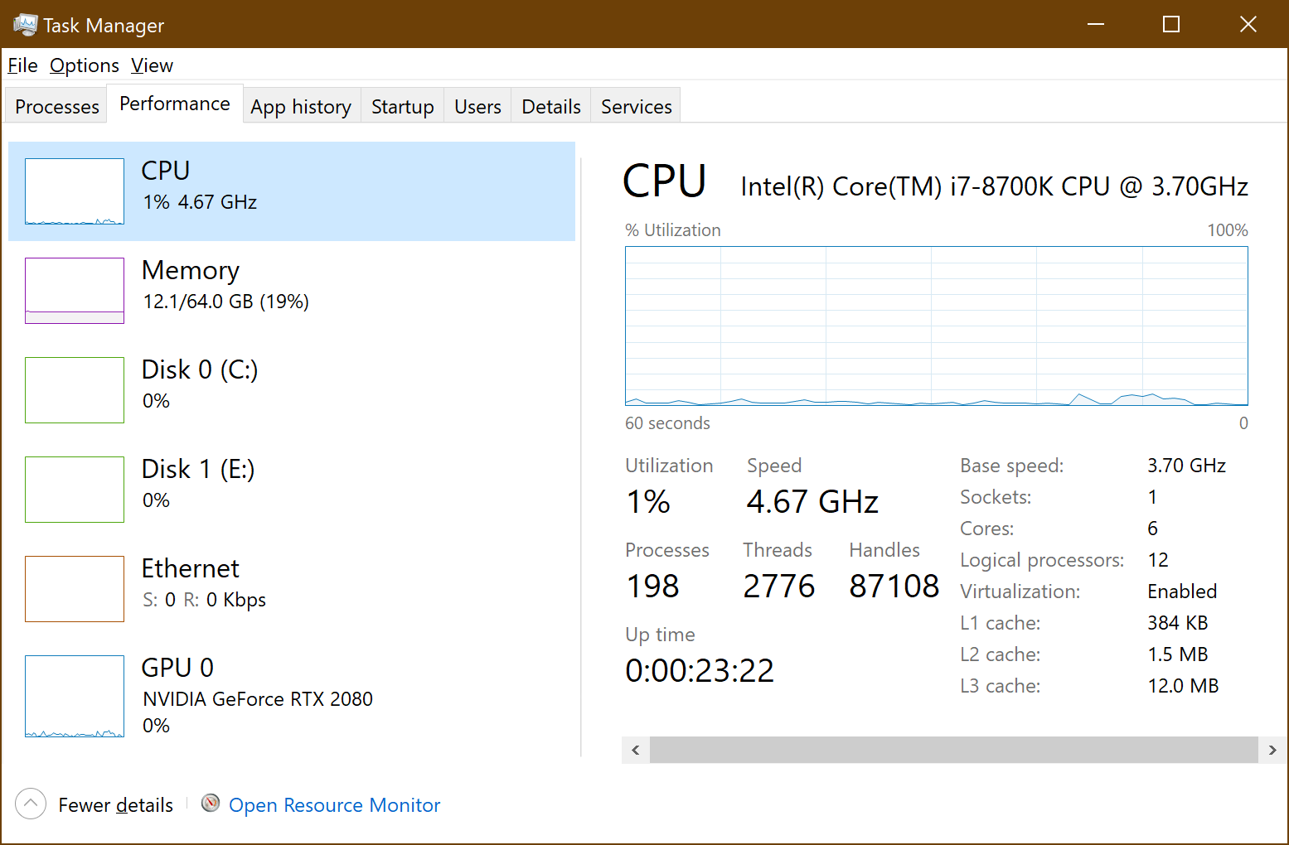
CPU Laymen Overview
Windows Task Manager:
Clock Speed
4.67 GHz
6 Cores
Relates to Hyperthreading; Different Discussion

Slide 3
Serial Instruction Processing
Please Excuse My Dear Aunt Sally
1 Core | Serial instructions:
Exponential Bunnies = | 2^3^2^4=
1
2
Bunnies
16,777,216
3
4
5
6

Slide 4
No No
Wrong..
Parallel Instructions | Parallel Instructions
Multiples of Bunnies = | 2^2=
Multiples of Bunnies = | 2^4=
1
2
Bunnies
8
16
3
4
5
6
Parallel Instructions | Parallel Instructions | Bunnies
Mutations of Bunnies? | 8^16= | 4,294,967,296

Slide 5
Serial Instruction Processing
This can easily be parallelized!
1 Core | Serial instructions:
Multiples of Bunnies = | 2*8*6*7*5*7*2*8*6*7*5*7=
1
2
Bunnies
553,190,400
3
4
5
6

Slide 6
Parallel Processing
We can easily parallelize instructions that can be processed independently
1 Core | Serial instructions:
Multiples of Bunnies = | 2*8*6*7*5*7*2*8*6*7*5*7=
1
2
6 Cores | Parallel Instructions
Multiples of Bunnies = | 5*6=
Multiples of Bunnies = | 8*5=
Multiples of Bunnies = | 6*7=
Multiples of Bunnies = | 7*7=
Multiples of Bunnies = | 2*7=
Multiples of Bunnies = | 2*8=
30
40
42
49
14
16
3
4
5
6

Slide 7
Parallel Processing
1 More Step
1
2
Bunnies
553,190,400
1 Core | Serial Instructions
Multiples of Bunnies = | 40*14*30*42*16*49=
3
4
5
6

Slide 8
Instructions that must be computed in sequence
()

Slide 9
GPU
Don’t have to be expensive

Slide 10
Recurrent Neural Network

Slide 11
Setting up Environment
Re-useable guide
Be careful with Nvidia driver updates; they do it often and do not auto install

